Slide 1


Proposing advancements in Machine Learning, NLP, and Language Technology for enriching Bengali in AI and IT with Generative AI.
Proposing a generative AI system, merging Machine Learning, NLP, and Language Technology, to elevate Bengali language in line with Bangladeshi news standards. This innovation addresses linguistic diversity, preserves cultural nuances, and empowers Bengali content creation, aligning with the global strides in Artificial Intelligence and Information Technology.

Slide 2

Maintainance Standard News Article Headlines
We often struggle to produce standard news article headlines in Bengali language, lacking the sense of attractiveness and awareness of the rules and regulations governing news creation, resulting in non-standard article headlines. To address this, we propose developing a new generative AI system to assist reporters in creating standardized news article headlines effortlessly.

Slide 3




Existing Model Example and Its Resistance
GPT model
DataSet
Rules
Structure
Grammar
There is lack of data set to train the model in bangla
Doesn’t maintain standard rules
Doesn’t make proper structured article
The GPT model can’t maintain grammar properly

Slide 4
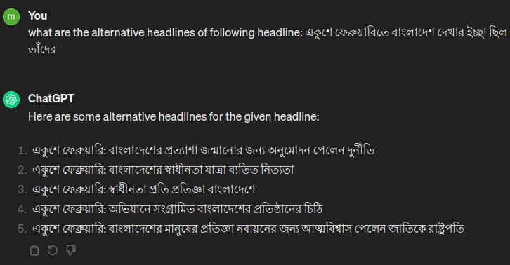
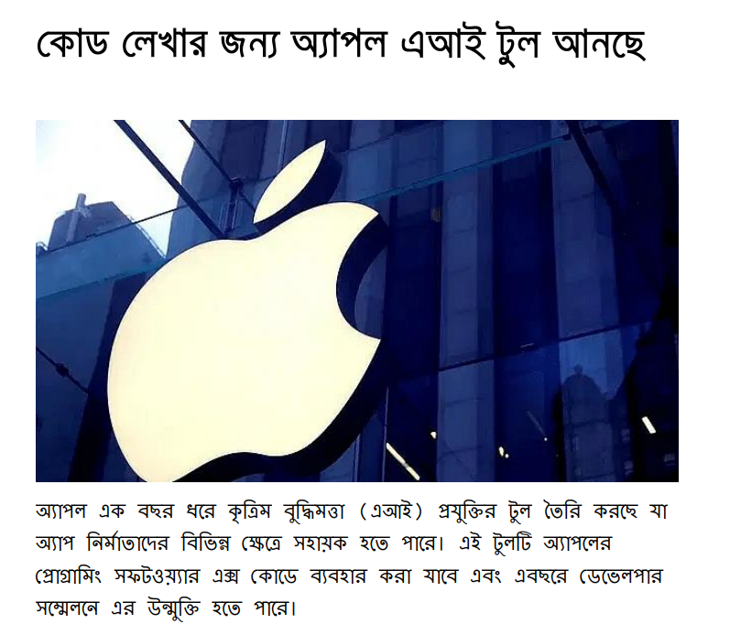
Problem Example
Unstandard news article headlines generated by GPT
News article headline created by the user contains improper style and violate certain rules. It also has poor Bengali language usage.

Slide 5
Our Idea Details
This research paper presents a novel approach to headline generation and evaluation using generative AI technology, specifically tailored to meet the standards of Bangladeshi news content. With Bangladeshi news article headlines characterized by distinct rules and constraints, and with readers placing particular emphasis on headlines, our study aims to address this demand. Leveraging a dataset comprising newspaper contents, we meticulously analyze the rules, regulations, and constraints governing news article composition in Bangladesh. Subsequently, we develop a generative AI model capable of generating headlines from minimal input information while conforming to these established standards. Furthermore, we integrate a mechanism to measure the effectiveness of generated headlines in resonating with Bangladeshi readers' emotions and enticing them to engage with the articles. Our research contributes to enhancing headline-generation techniques, catering specifically to the preferences and expectations of Bangladeshi news consumers.

Slide 6
Workflow to create our Generative AI
Dataset
Improve Accuracy
Train Model
Deploy Product
Create a large dataset of news article
Improve accuracy by learning the Bangla grammar, rules, and structure
Train the model with the data set
Deliver a helpful software or website so that normal people can use it

Slide 7
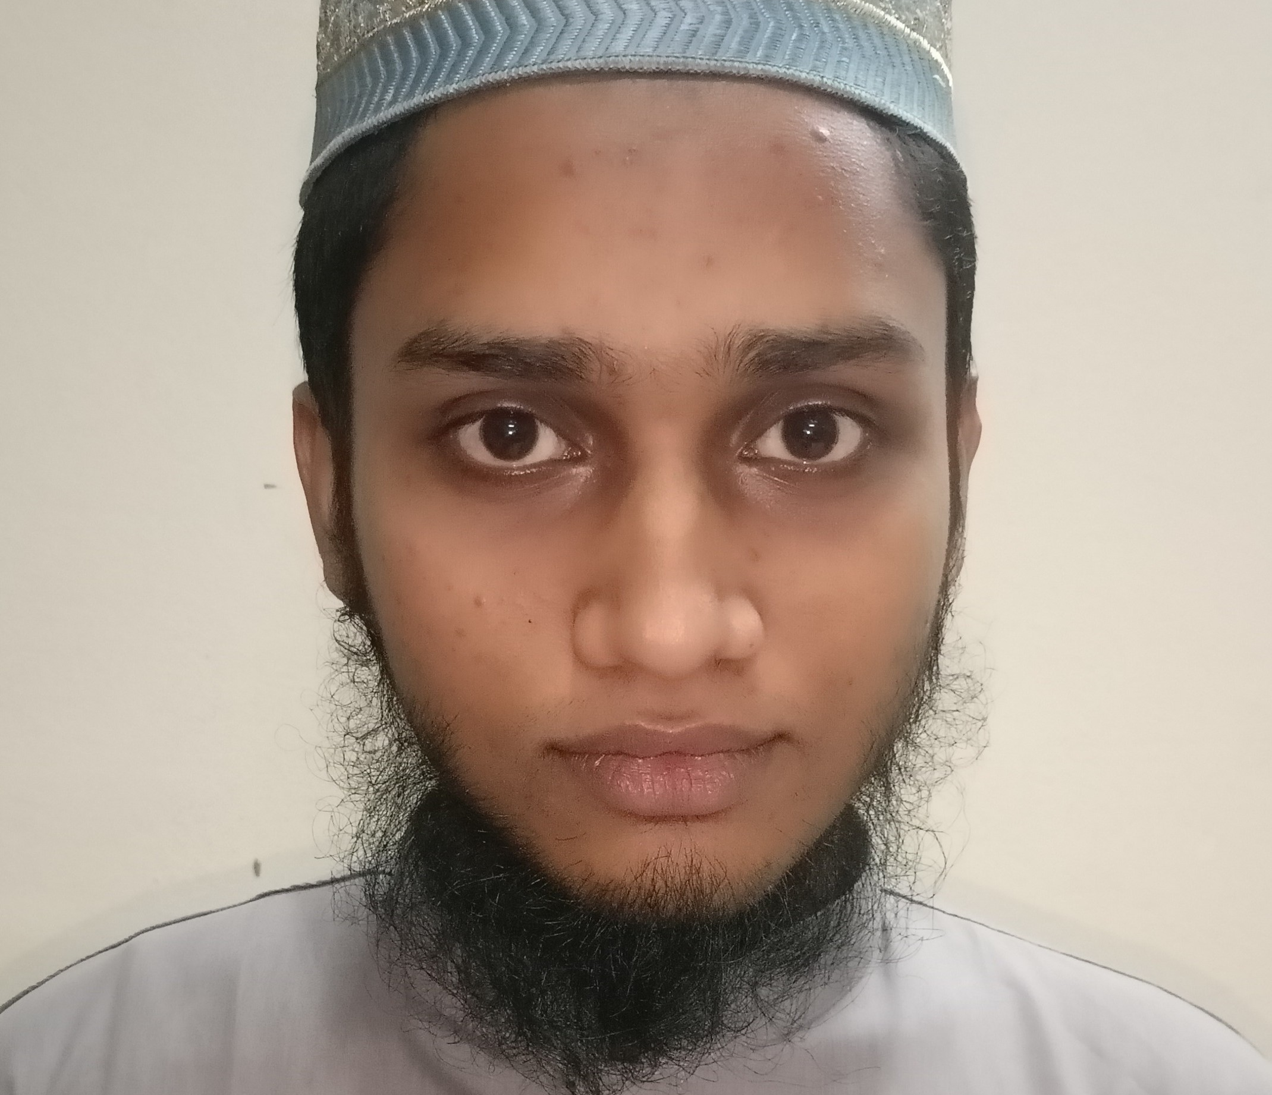

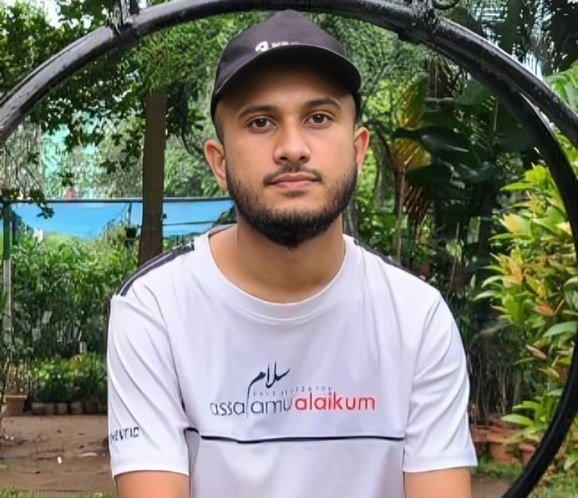


SUST_DataSet
01
02
Siam Arefin
Nafi
03
04
05
Farzine
Nixon
Sawon

